Slide 1
Presenter Name: Habib Ullah
Master Name: Mr. Guo QingShuai

Slide 2
Arresters

Slide 3
Introduction:
Over voltages in power system may occur due to lightning, fault or switching operation. These over-voltages could reach dangerous amplitudes for power system apparatus. To protect the system electrical equipment and to guarantee an economic and reliable operation, arresters are applied in almost all types of electrical power network. Gapless zinc oxide (ZnO) arresters are widely used. Arresters are usually connected between the phase and ground terminals. They limit the voltage level in equipment such as transformers below the withstand voltage level.

Slide 4
Zinc Oxide (ZnO) Arrester:
The construction of ZnO arresters consist of a very simple structure. They basically consist of an insulating housing which is made of porcelain or polymeric material, and the inner active column, composed of the ZnO arresters is shown in Figure-1.1. The ZnO arrester block elements are the main component of the ZnO arrester. They provide the desired non-linear characteristics. The non-linear resistivity is an inherent bulk property of the composite ceramic resistor, which consists of mainly ZnO with relatively small amount of several additives of other metal oxides such as Bi2O3, CoO2, MnO3, and Sb2O3. These additives essentially determine the electric properties of the block arresters element.

Slide 5
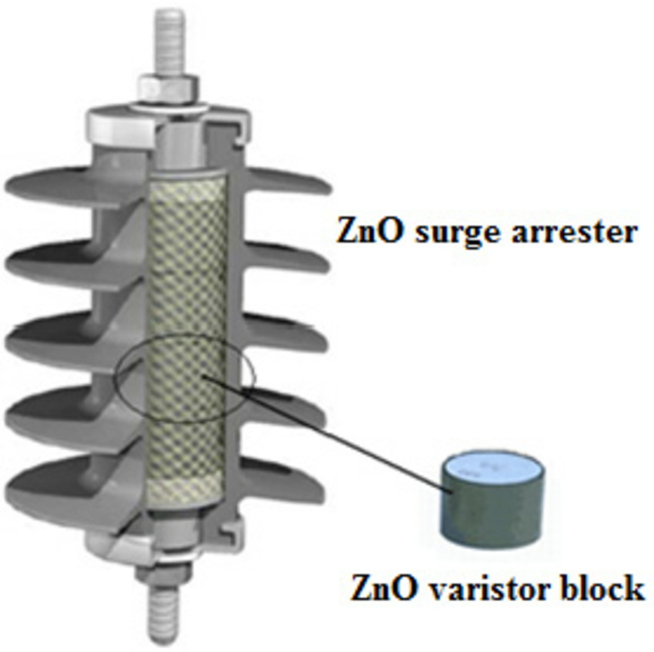
Figure-1.1: ZnO Arrester Construction

Slide 6
The selection of arresters is based on the operating voltage across them with consideration temporary over-voltages, harmonics and communication overshoots when applicable. The discharge duties and coordinating currents are defined by the studied faults cases or are by experience well known.
In our project, at Lahore converter station, we used two kind of Arresters:
Lightning Arresters
Surge Arresters

Slide 7
Lightning Arrester
Role of Arrester:
When the peak value of the over-voltage caused by the thunder or the circuit switch exceeds the standard value, it limits the over-voltage, protects the insulation of the electrical installation, and prevents the normal state of the system from being disturbed, and realize automatic recovery.
Arrester Model:
An arrester is represented by specific sequence of numerical and alphabets which have special meanings. Figure-1.2 shows the ordering information of surge arrester.

Slide 8
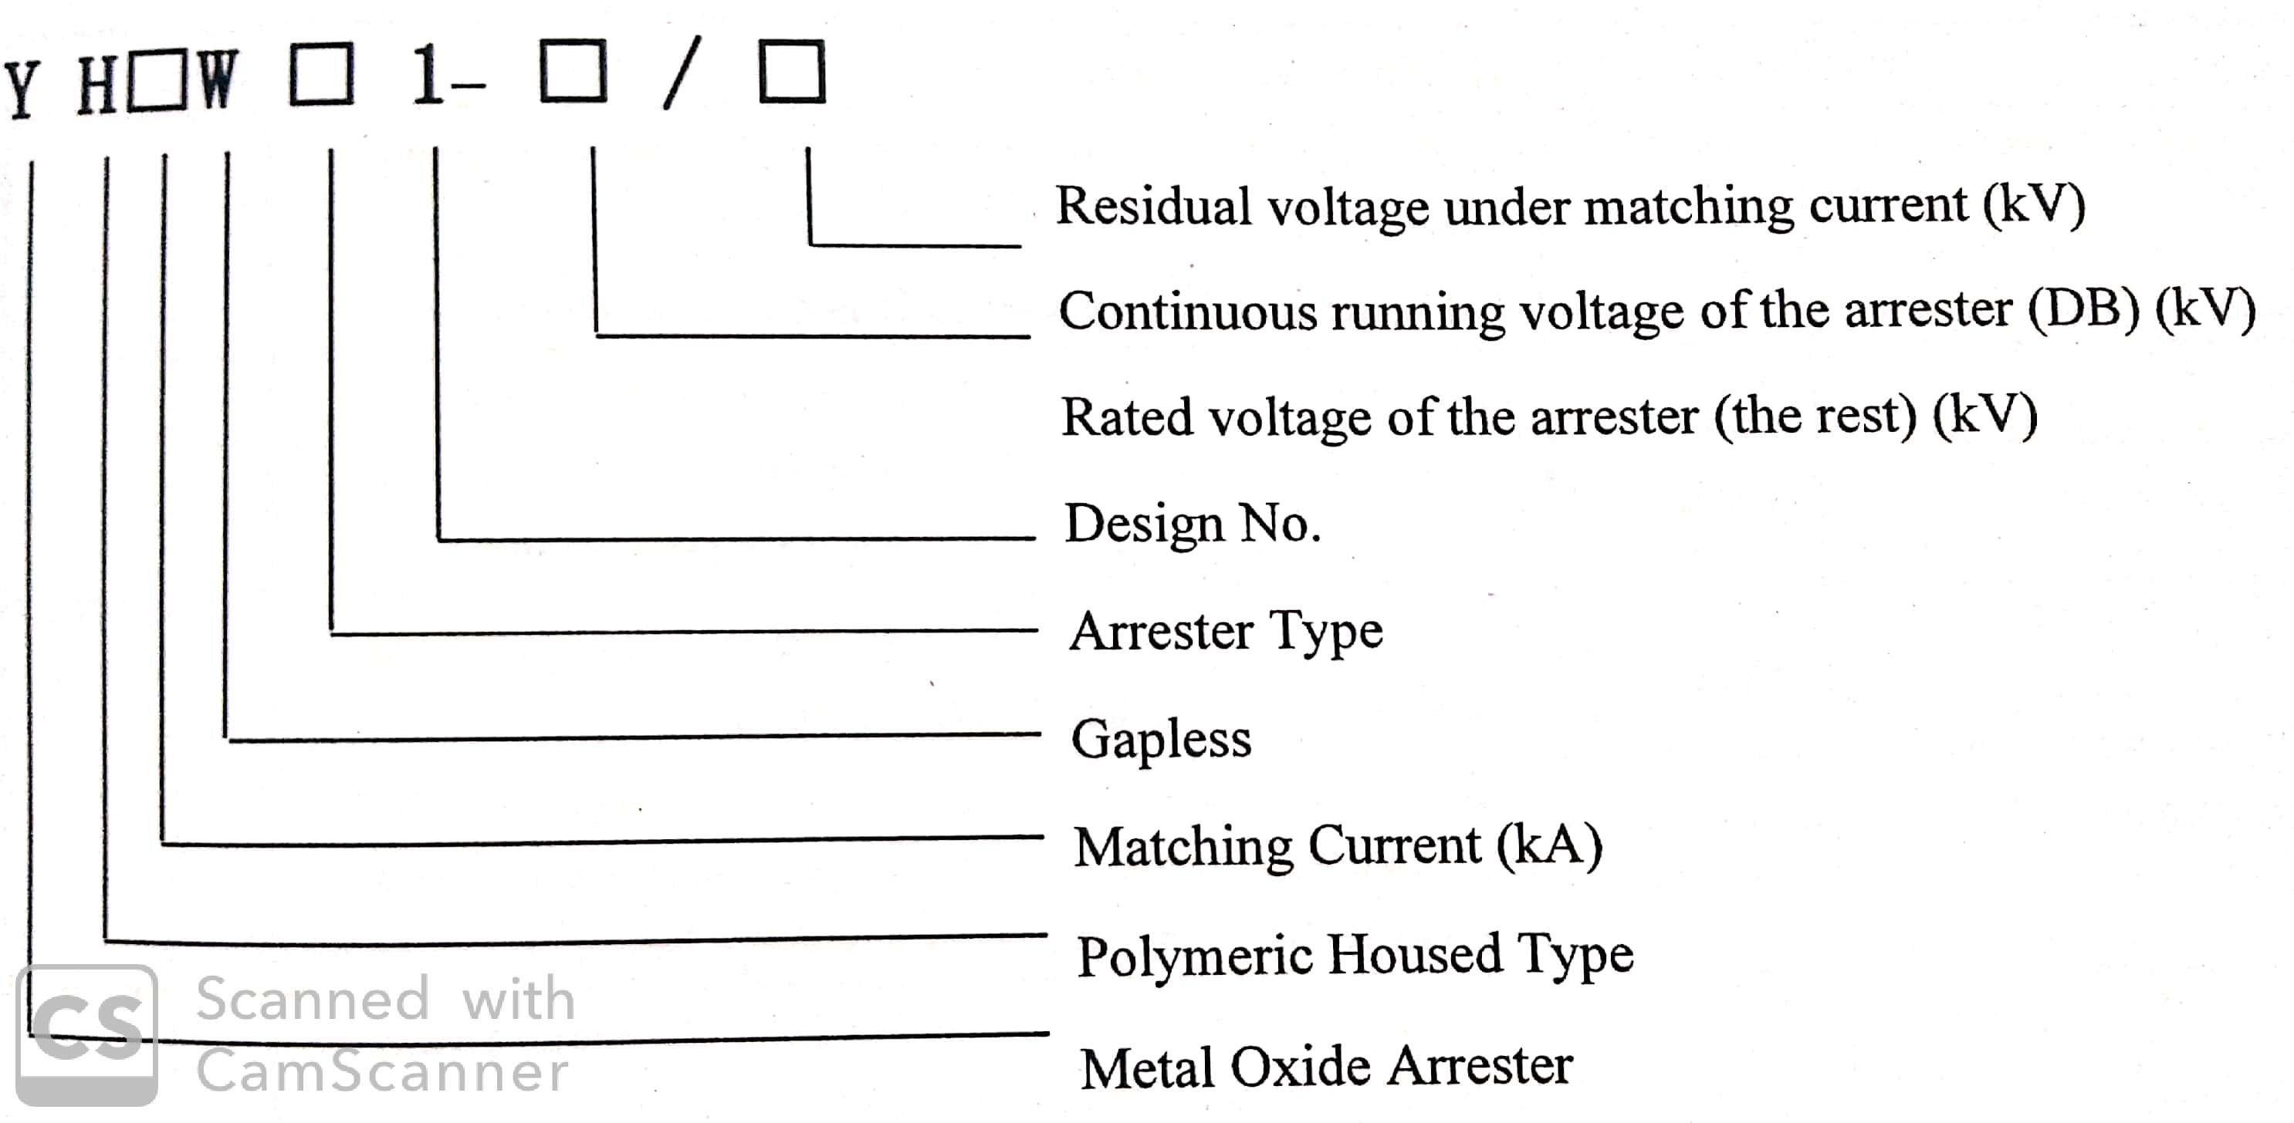
Figure-1.2: Surge Arrester Model Explanation

Slide 9
Arrester Type:
No. | Type | Arrester Name | Arrester Model
1 | CBH | 660kV valve hall DC polar Arrester | YH2WCBH1-709/1416
2 | M | 6-Pulse bridge Arrester | YH2WM1-384/754
3 | CBN1 | Valve Hall neutral bus arrester | YH2WCBN1-230/451
4 | DB | 660kV outdoor DC polar Arrester | YH20WDB1-680/1448
5 | DL | 660kV outdoor DC polar Arrester | YH20WDL1-680/1448
6 | CBN2 | Neutral Bas Arrester | YH2WCBN1-207/392
7 | E | Neutral Bas Arrester | YH5WE1-163/369
8 | EL | Grounding Polar Arrester | YH10WEL1-131/277
9 | EM | Metal Return Transfer Bus Arrester | YH20WEM1-163/412
Table-1.1 shows different types of Arrester.

Slide 10
Arrester | PCOV | CCOV | Uref | LIPL | SIPL | U500A (kV) | U10Ka (kV) | Col | Energy
M |  | 445 | 542.7 | 754.6/2 | 722.4/0.5 | 754.6 |  | 4 | 15.3
DB |  | 680 | 851 | 1448/20 | 1228/1 |  | 1448 | 2 | 12.1
CBH |  | 801 | 1002 | 1416/2 | 1384/1 |  |  | 3 | 15
CBN1 | 168 | 130 | 325 | 451/2 | / | 451 |  | 2 | 6
CBN2 | 168 | 130 | 292.6 | 392.4/2 | 421.3/8 | 409.6 |  | 8 | 15.9
EL |  | 20 | 184.8 | 277.7/10 | 272.1/6 | 258.7 |  | 6 | 7.9
EM |  | 20 | 231 | 412.9/20 | 365.4/5 | 323.4 |  | 2 | 2.29
V1 | 492.2 | 413.6 | 348.1RMS | 651/2 | 677.2/5 | 660.7 |  | 6 | 13.8
V2 | 492.2 | 413.6 | 348.1RMS | 660.7/2 | 683.2/4 | 660.7 |  | 4 | 9.2
DL | - | 680 | 851 | 1448/20 | 1228/20 |  | 1448 | 2 | 12.1
E | - | 20 | 231 | 369.6/5 | / | 323.4 |  | 2 | 4.2
A | - | 318 | 396RMS | 965/20 | 761/8 |  | 872 | 1
DR | - | 72 | 470RMS | 875/1 | - | 845 |  | 1 | 5
Table-1.2 shows the protection levels of different Arrester types.

Slide 11
A valve Arrester:
It is used to protect the converter valve from damage resulting from excessive voltage. The valve arrester determines the required phase insulation level of the converter transformer’s valve side. The insulation level of the transformer valve-side winding and each point depend on protection levels of the valve of the lightning arrester and other series of valve arrester.
A DC Neutral Point Bus Arrester:
The DC neutral point bus arrester is adopted to protect the bridge arm from overvoltage damage.

Slide 12
A Converter Lightning Arrester:
Adopted to limit the overvoltage amplitude resulting from the intrusion of lightning into the valve hall.
A DC Bus Arrester:
Adopted to protect equipment in the DC field from overvoltage damage. The arrester F4 is used to protect the station equipment from over-voltage surges and prevent them from entering into the system. It neutralize the over-voltage by grounding them and the system remains safe and keep working normally.

Slide 13
A Neutral Bus Arrester:
Adopted to protect the neutral bus connecting equipment from overvoltage damage. Arrester F2 is used to protect the system from being damaged by over-voltage surges. And the combination of F1 and T3 is used for the measurement of current.

Slide 14
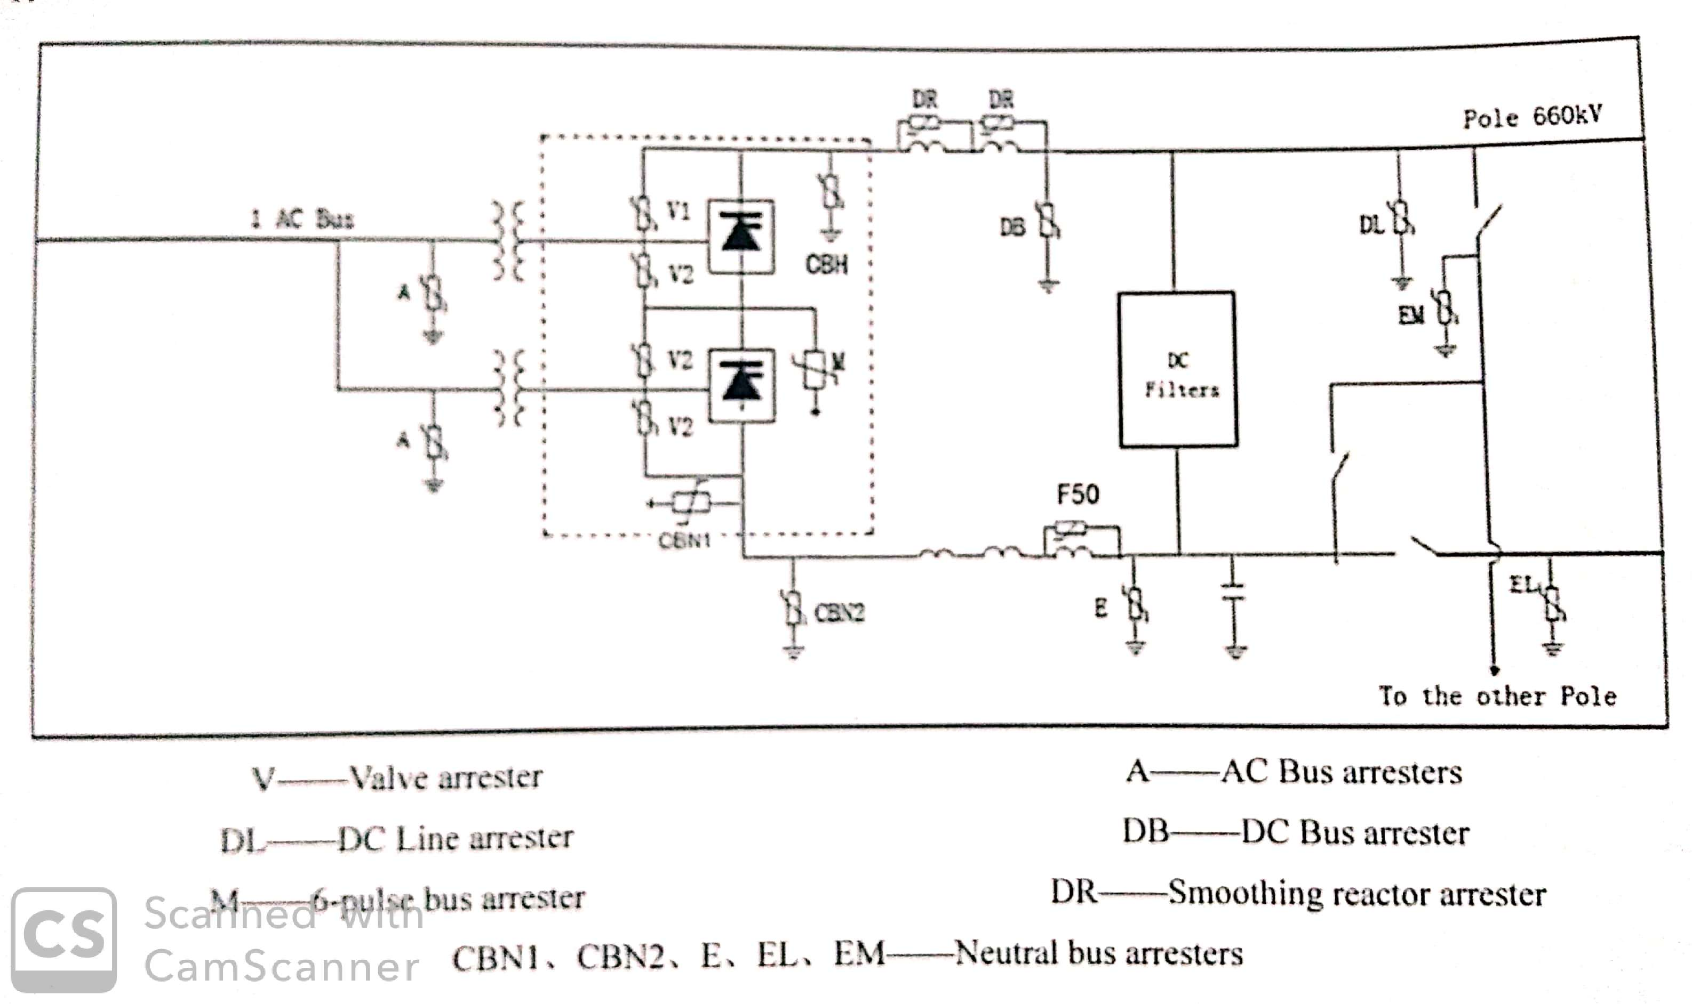
Arrangement of Arresters

Slide 15
Surge Arrester:
The Surge arrestors are electrical products which are used to protect the power transmission and transformation equipment from being damaged by the atmospheric pressure and switching over-voltages. Because ZnO resistor has very excellent non-linear volt-ampere characteristic, there is only several hundred micro-amps of current passing through it under normal working voltage. Therefore, it can be designed as non-gap structure, which makes it have the characteristic of small size, light weight and good protection property. When the voltage invades, the current running through the resistor increase quickly, and the amplitude of over-voltage is restricted and the energy of over-voltage is released. Later, ZnO resistor resumes its high resistance state and enables the power system to function normally.

Slide 16
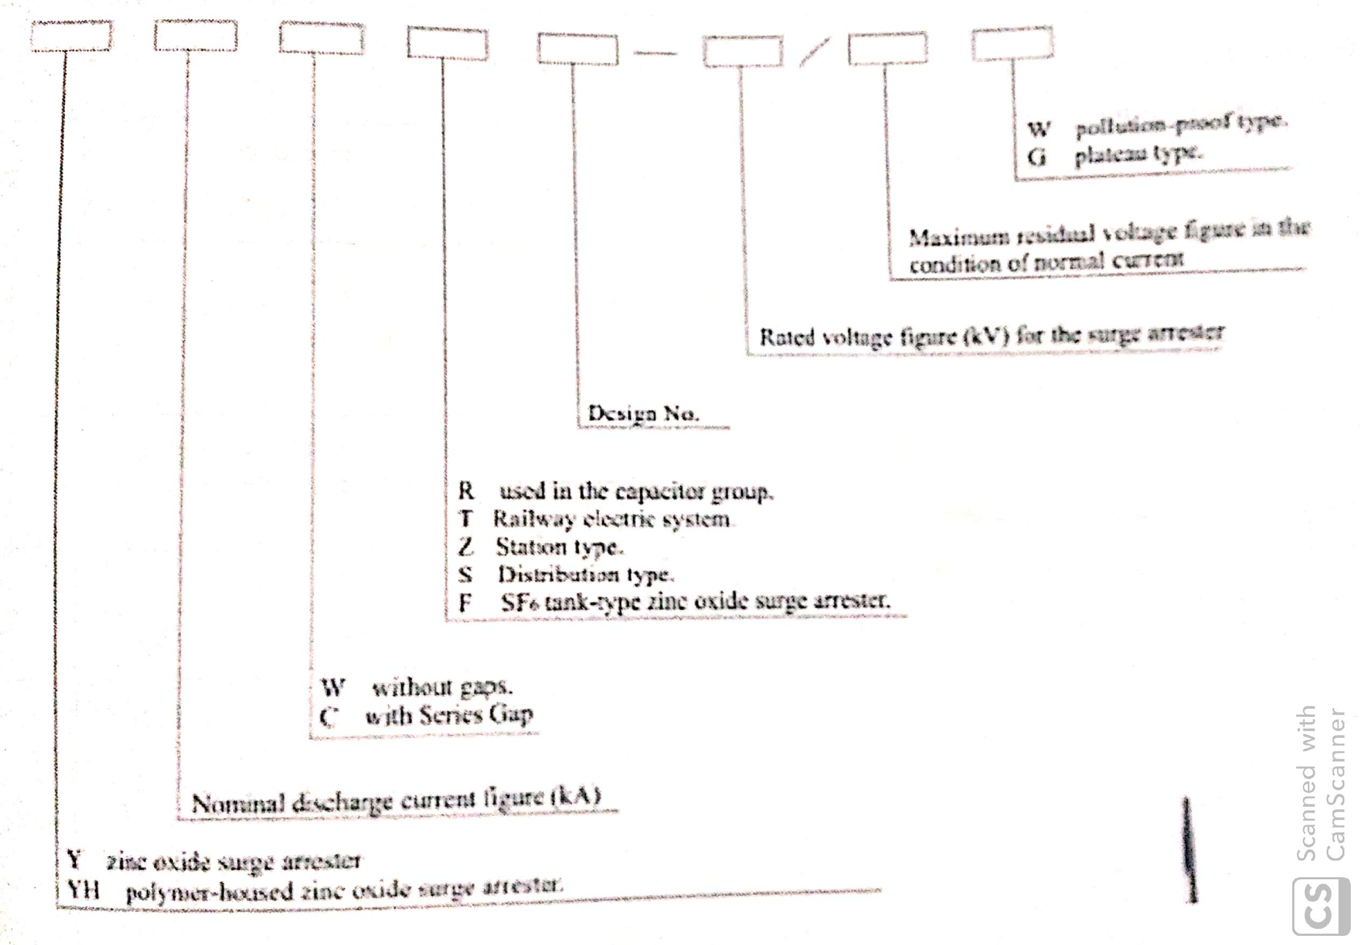
Model Explanation:
Figure-1.4 consist ordering information about surge arresters.

Slide 17
AC Surge Arresters at Lahore Converter Station:
Table-1.3 consists the information about the AC surge arresters installed at Lahore Converter Station.
Sr. | Filter Type | Quantity | Model
1 | HP 12/24 High End | 24 Set | Y71W1-144/354W
2 | HP 12/24 Low End | 24 Set | Y10W1-48/109.2W
3 | SC (Parallel HV condenser Group) | 24 Set | Y67W1-144/351W
Table-1.3: Lahore Converter Station AC Surge Arresters.

Slide 18
DC Surge Arresters at Lahore Converter Station:
Table-1.4 consists the information about the DC surge arresters installed at Lahore Converter Station.
Sr. | Filter Type | Quantity | Model
1 | HP 12/24 HV | 2 Set | Y75.5W1-177/435W
2 | HP 6/42 HV | 2 Set | Y91W1-219/557W
3 | HP 12/24 HV L1 | 2 Set | Y7.6W1-186/412W
4 | HP 6/42 HV L1 | 2 Set | Y11.9W1-219/512W
5 | HP 12/24 Low End | 2 Set | Y10W1-63/125W
6 | HP 6/42 Low End | 2 Set | Y10W1-66/134W
Table-1.4: Lahore Converter Station DC Surge Arresters.

Slide 19
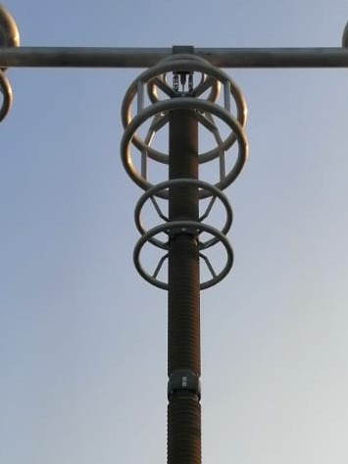
DC Bus Arrester

Slide 20
Thank You

